Slide 1
BRCA TP53

Slide 2
Data Source
UCSC xena datapages
TCGA BRCA
Clinical data(https://xenabrowser.net/datapages/?dataset=survival%2FBRCA_survival.txt&host=https%3A%2F%2Ftcga.xenahubs.net&removeHub=https%3A%2F%2Fxena.treehouse.gi.ucsc.edu%3A443)
Mutant information (MC3 mutation calls) https://xenabrowser.net/datapages/?dataset=mc3%2FBRCA_mc3.txt&host=https%3A%2F%2Ftcga.xenahubs.net&removeHub=https%3A%2F%2Fxena.treehouse.gi.ucsc.edu%3A443
Illumina HiSeq, RSEM normalized results
Notes:
The MC3 is a variant calling project of over 10,000 cancer exome samples from 33 cancer types.

Slide 3
1097 primary tumor
259 with single TP53 mut + 7 with 2 TP53 mut
831 TP53 WT
15 with R175
8 with R248
17 with R273

Slide 4
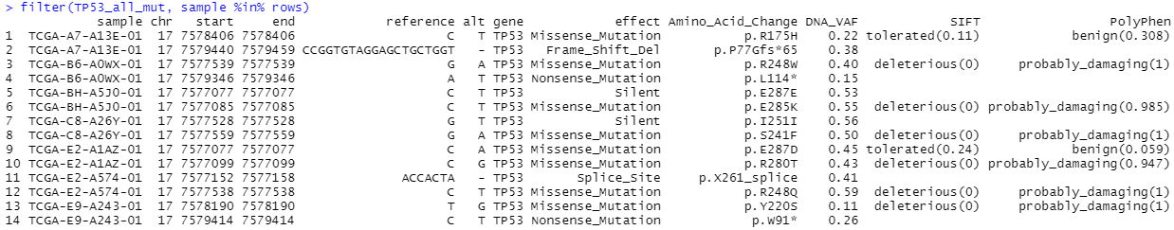
Some features of BRCA MC3 data
Some BRCA samples contained more than 1 TP53 mutations
Was grouped into “TP53 Multiple Mutation” in later analysis
> gene.of.interest [1] "BRCA1" "SRSF2" "ATF4" "SLC7A11" "ZFAF1" "WT1" "PBRM1" "BAP1" "CDH1" "CIC" "RB1" "STK11" "SMAD4" "NF1" "TP53“
No samples are marked as ZFAF1 mutants
This database used SFRS2 instead of SRSF2 as gene id

Slide 5
Some features about BRCA mutect data
Within a single mutation type (for example TP53R273), the amino acid change can be different
> head(TP53_R273)
sample chr start end reference alt gene effect Amino_Acid_Change DNA_VAF SIFT PolyPhen
5209 TCGA-A2-A0CL-01 17 7577120 7577120 C A TP53 Missense_Mutation p.R273L 0.18 deleterious(0) probably_damaging(0.993)
6399 TCGA-A2-A0T1-01 17 7577121 7577121 G A TP53 Missense_Mutation p.R273C 0.18 deleterious(0) probably_damaging(0.998)
26962 TCGA-AR-A0TP-01 17 7577120 7577120 C G TP53 Missense_Mutation p.R273P 0.80 deleterious(0) probably_damaging(0.999)
28735 TCGA-AR-A1AJ-01 17 7577120 7577120 C T TP53 Missense_Mutation p.R273H 0.20 tolerated(0.13) possibly_damaging(0.631)
29386 TCGA-AR-A1AW-01 17 7577121 7577121 G A TP53 Missense_Mutation p.R273C 0.36 deleterious(0) probably_damaging(0.998)
30249 TCGA-AR-A24T-01 17 7577120 7577120 C T TP53 Missense_Mutation p.R273H 0.30 tolerated(0.13) possibly_damaging(0.631)

Slide 6
Pairwise comparison----Group settings
1. TP53 WT vs TP53 mutant
2. TP53 WT vs TP53 multiple mutant
3. TP53 WT vs TP53 R175
4. TP53 WT vs TP53 R248
5. TP53 WT vs TP53 R273
6. TP53 WT vs TP53 R175+R248+R273
Use EdgeR to complete gene expression analysis

Slide 7
Analyze the dataset without selecting gene of interest

Slide 8
Overview

Slide 9
Heatmap data source:
HiSeq Gene Expression from database, got log2(x+1) transformation and then used R scale() function to normalize (centering expression by gene)
Number > 2 = 2 red
Number < -2 = -2 blue

Slide 10
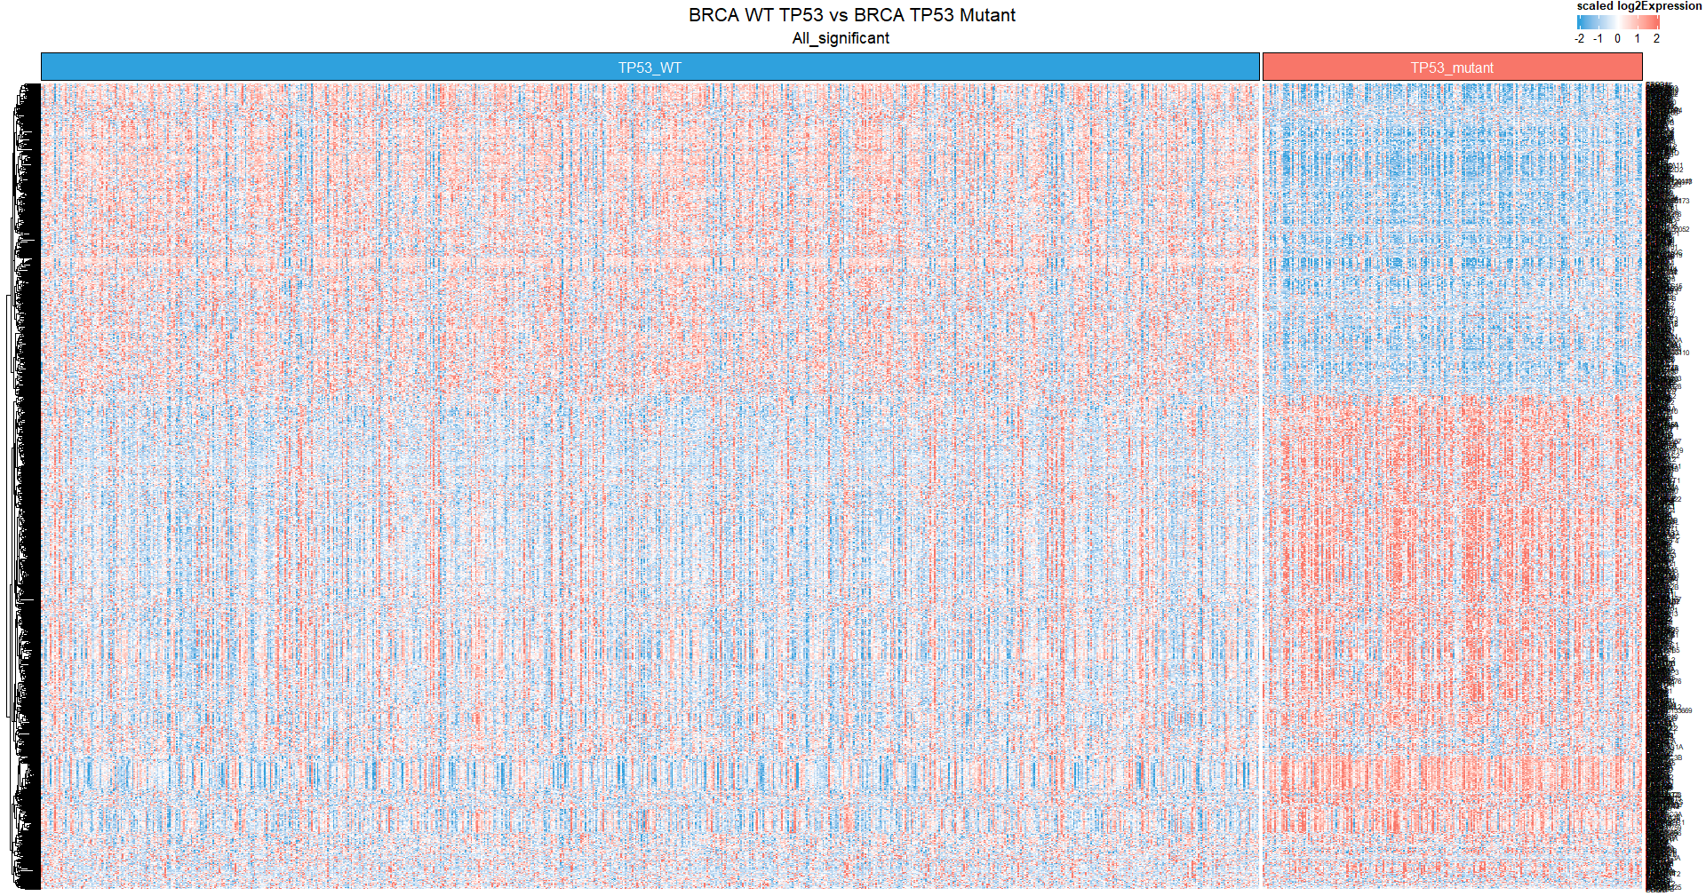
TP53 WT vs TP53 mutant

Slide 11
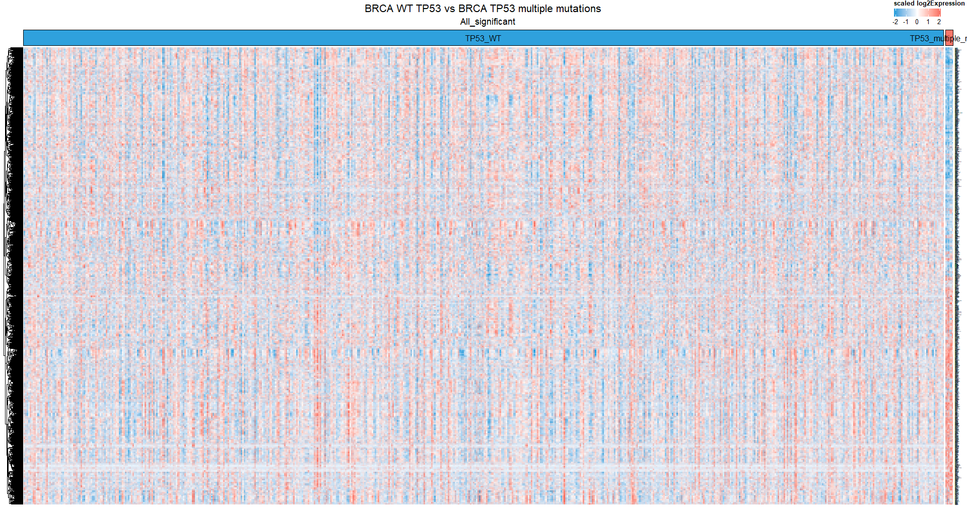
TP53 WT vs TP53 multiple mutant
TP53 WT vs TP53 R248

Slide 12
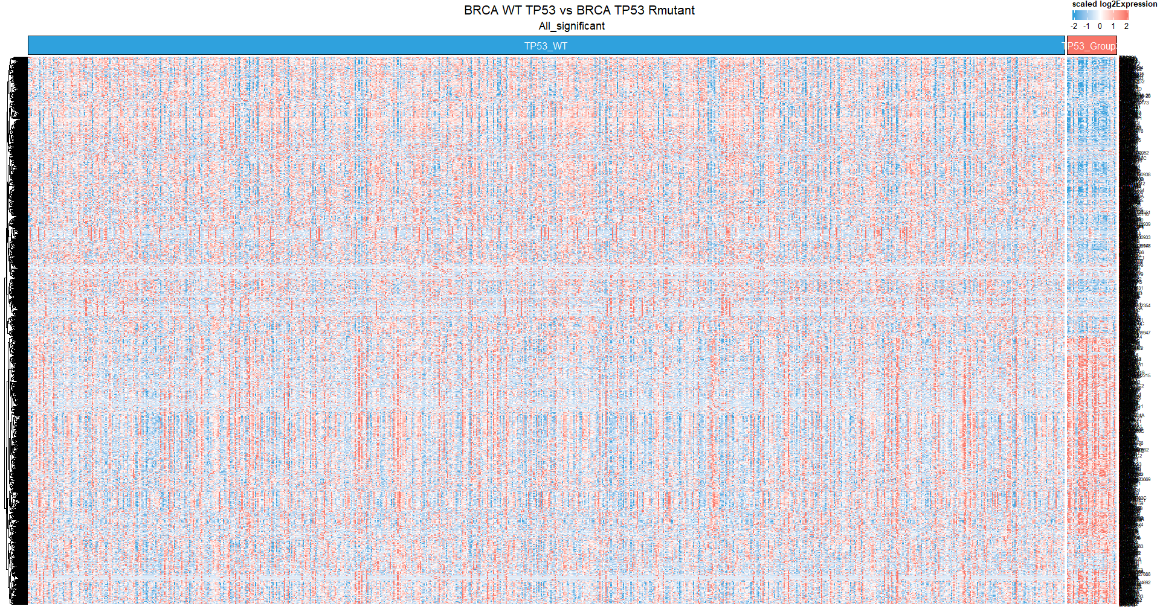
TP53 WT vs TP53 R175+R248+R273

Slide 13
Top 100 upregulated + downregulated genes
With KEGG

Slide 14
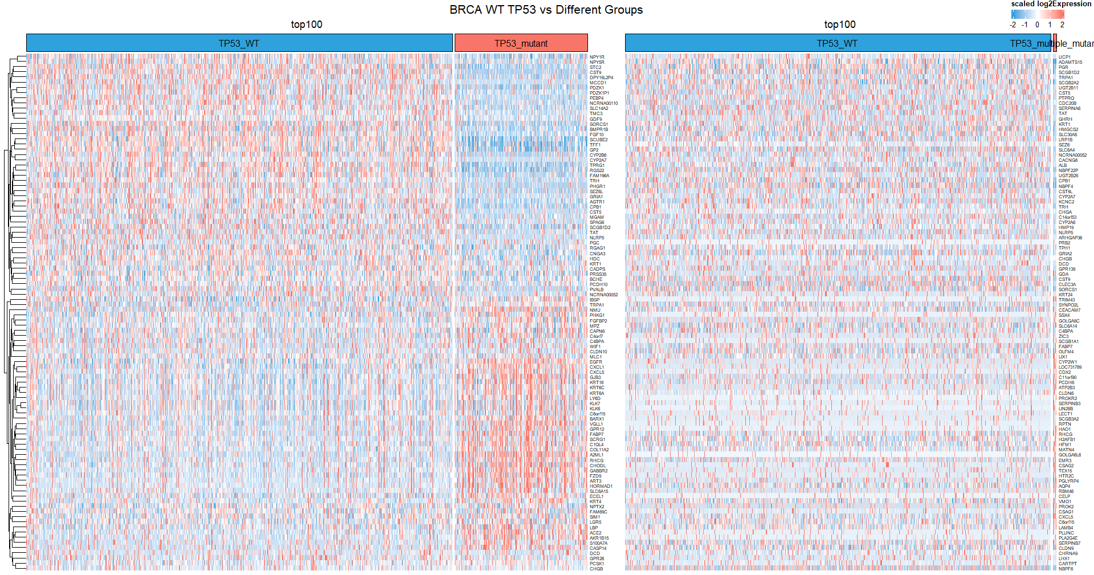
TP53 WT vs TP53 mutant
TP53 WT vs TP53 multiple mutant

Slide 15
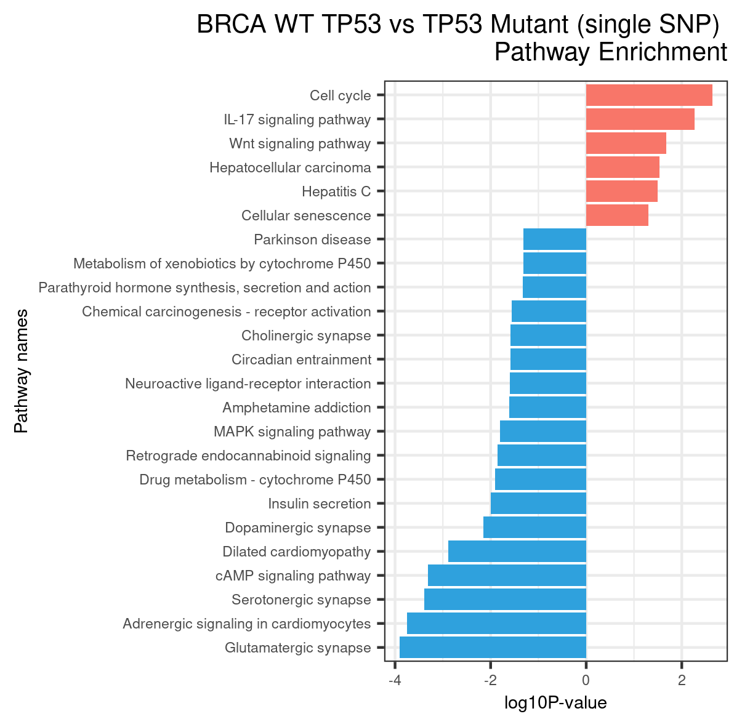
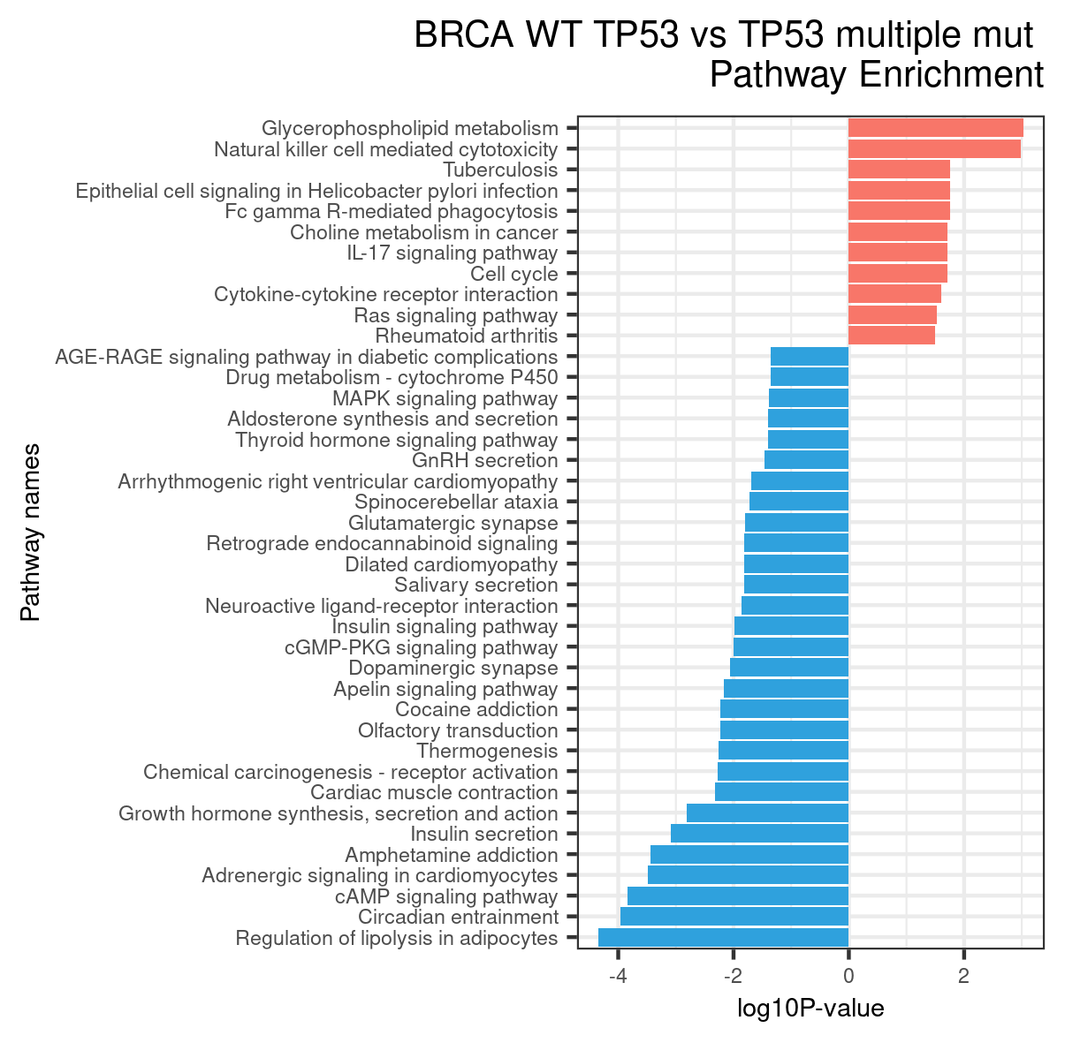

Slide 16
Gene of interest is within top 100 regulated gene?
TP53 WT vs TP53 mutant
No
TP53 WT vs TP53 multiple mutant
No

Slide 17
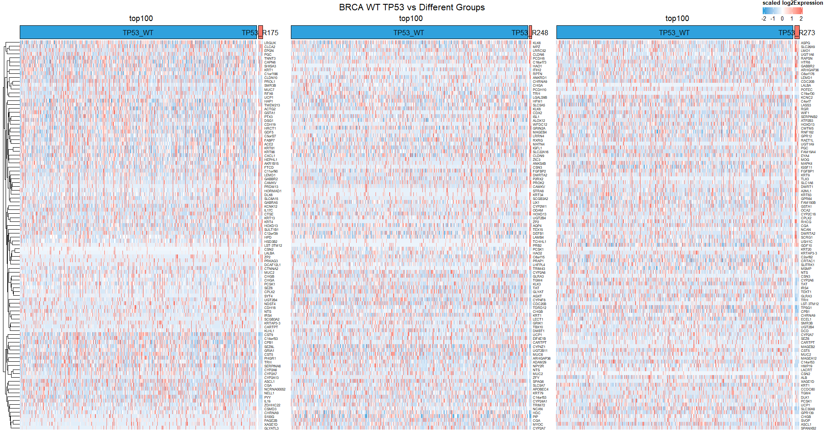
TP53 WT vs TP53 R175
TP53 WT vs TP53 R248
TP53 WT vs TP53 R273

Slide 18
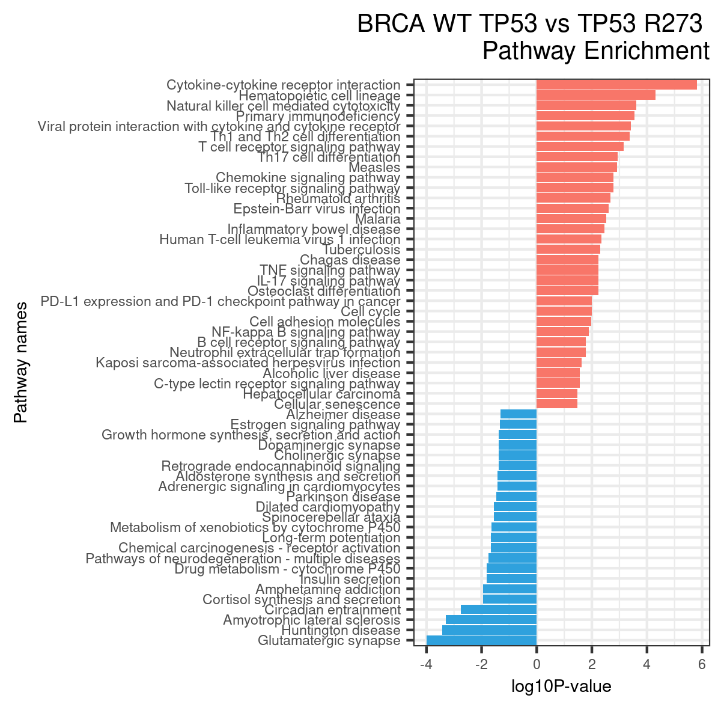
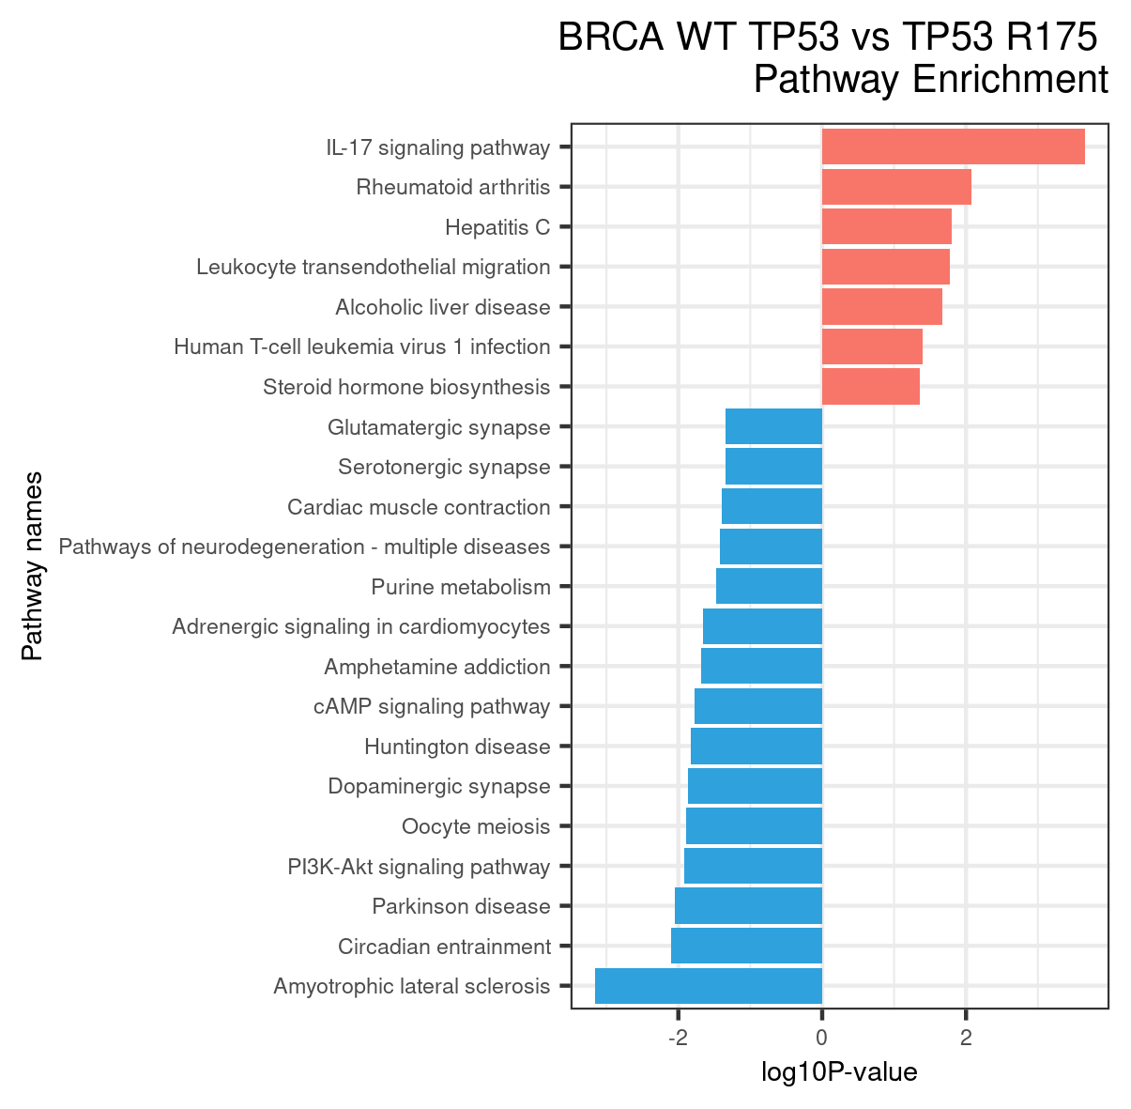

Slide 19
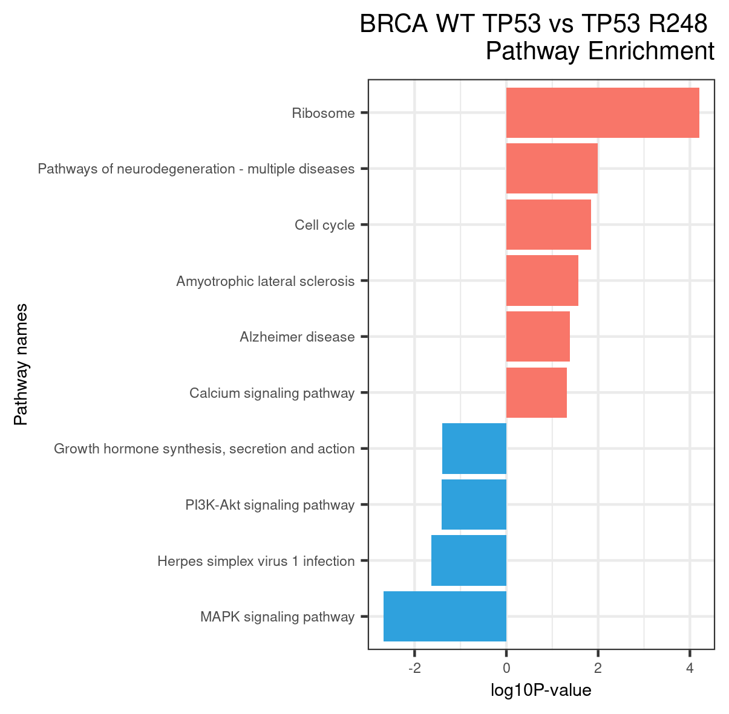

Slide 20
Gene of interest is within top 100 regulated gene?
TP53 WT vs TP53 R175
No
TP53 WT vs TP53 R248
No
TP53 WT vs TP53 R273
No

Slide 21
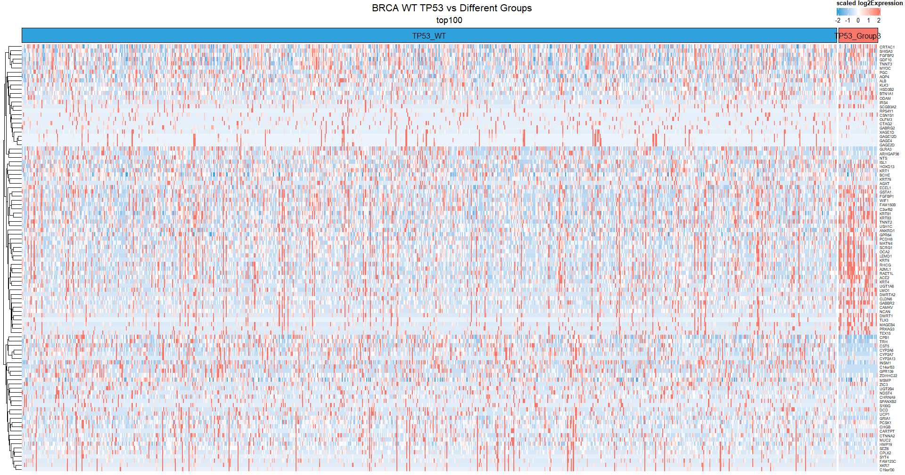
TP53 WT vs TP53 R175+R248+R273

Slide 22
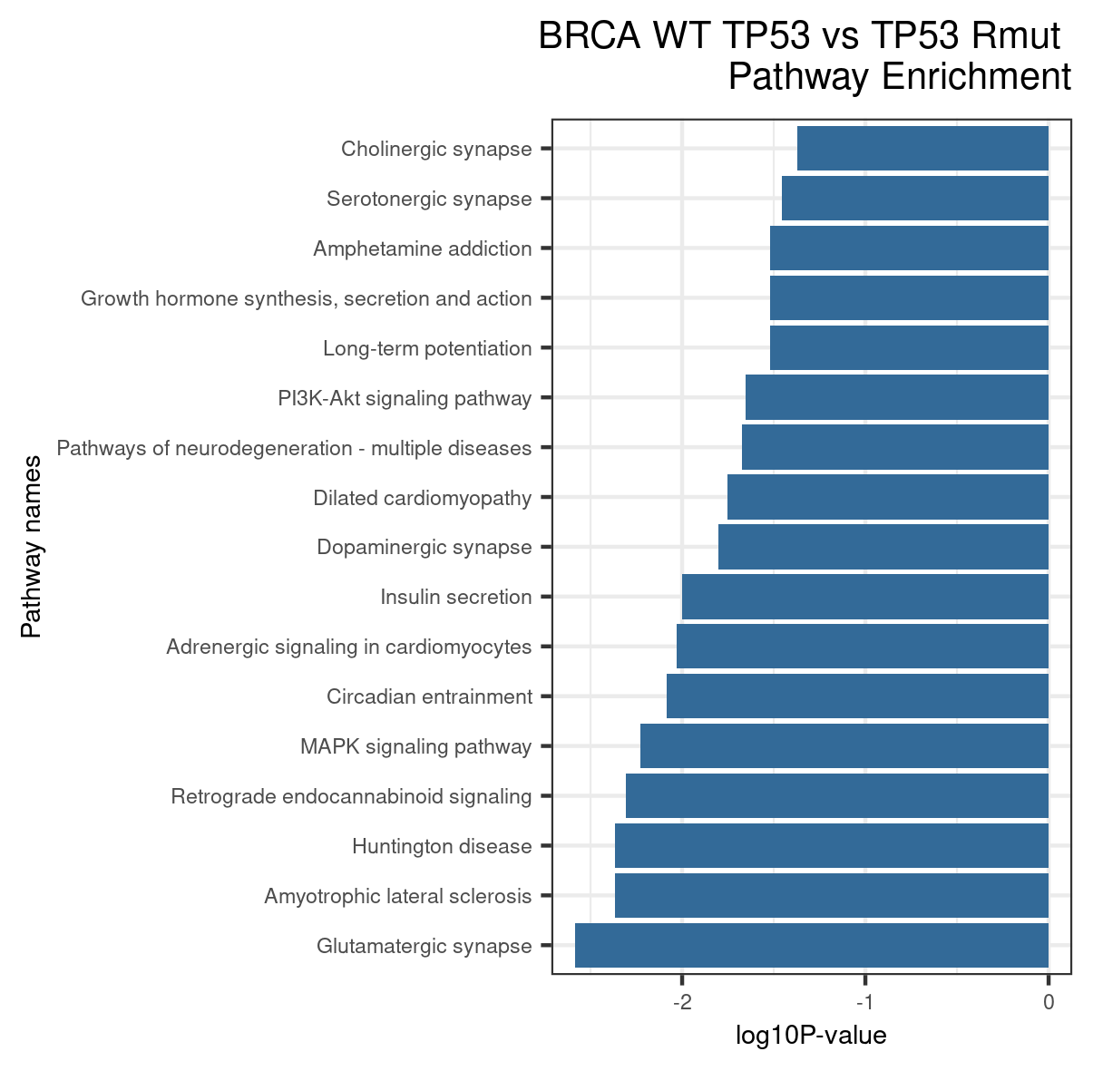

Slide 23
Gene of interest is within top 100 regulated gene?
TP53 WT vs TP53 R175+R248+R273
No

Slide 24
If only focused on samples contained all genes of interest
All failed KEGG, no enrichment

Slide 25
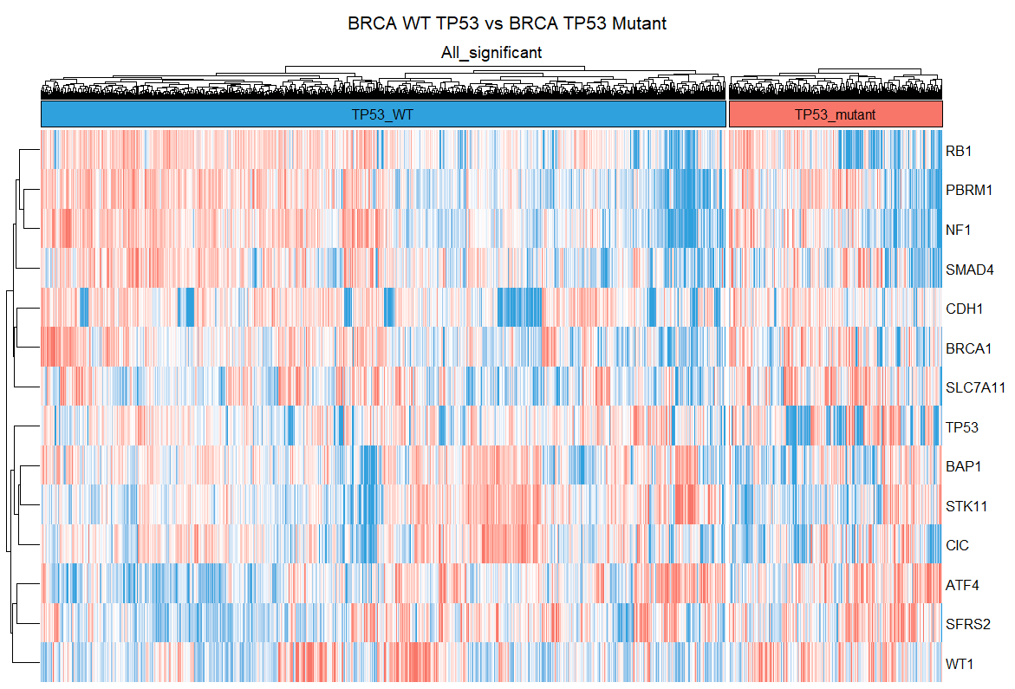
TP53 WT vs TP53 mutant

Slide 26
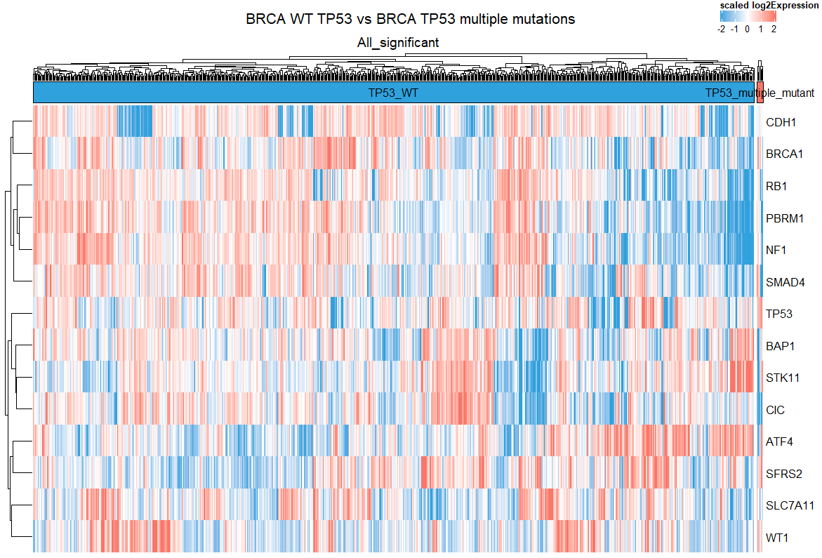
TP53 WT vs TP53 multiple mutant

Slide 27
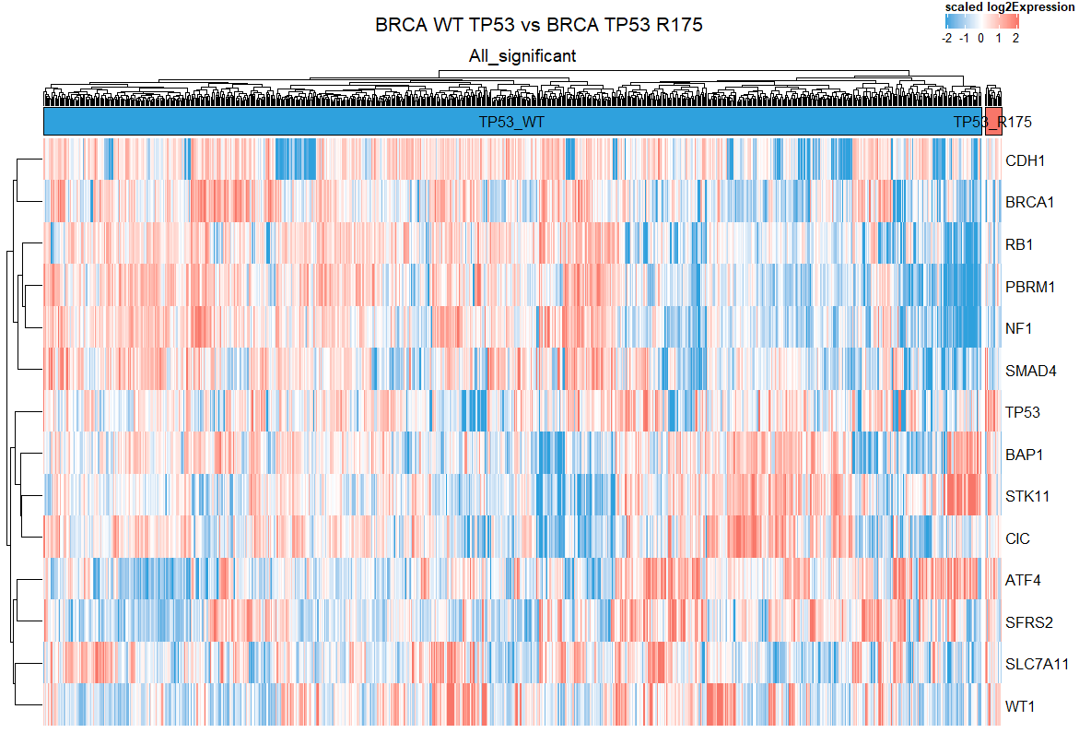
TP53 WT vs TP53 R175

Slide 28
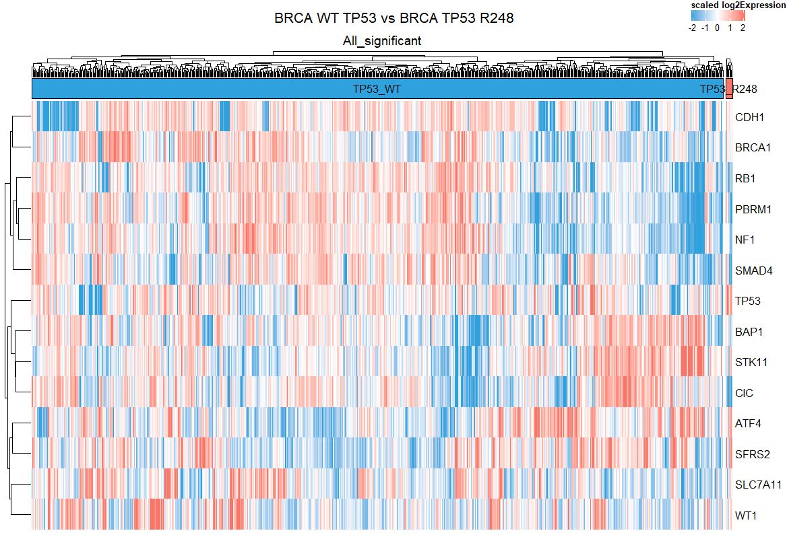
TP53 WT vs TP53 R248

Slide 29
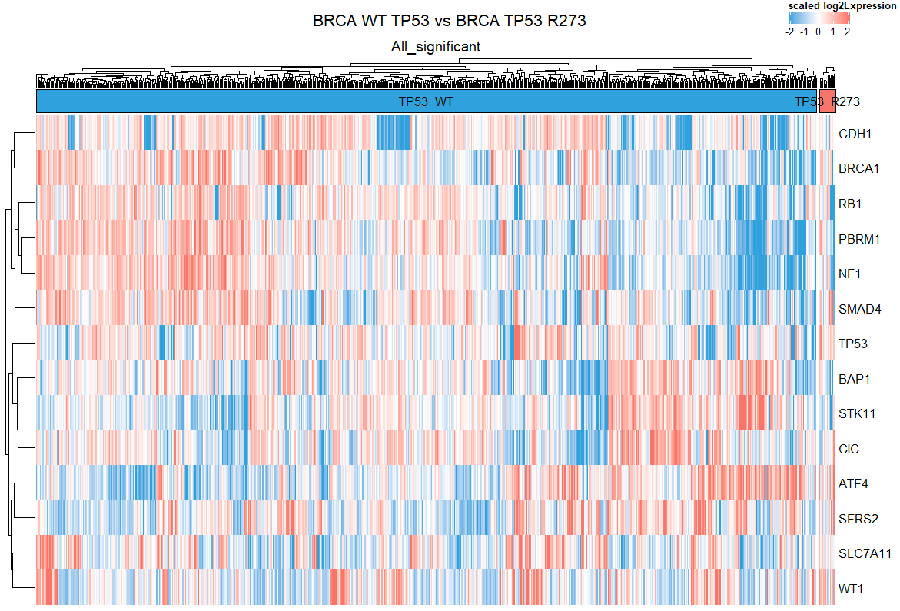
TP53 WT vs TP53 R273

Slide 30
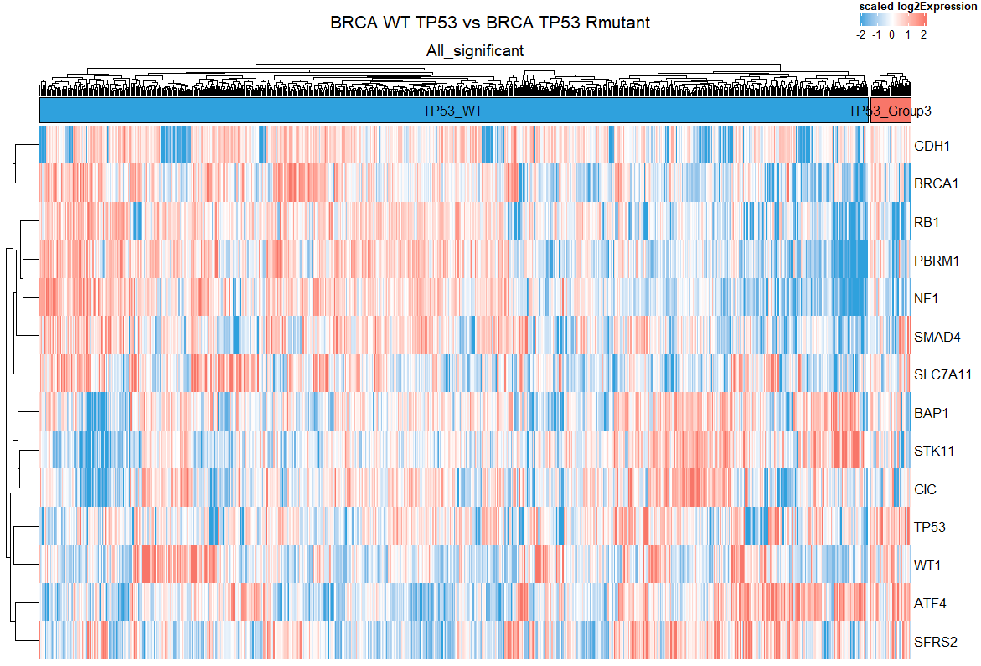
TP53 WT vs TP53 R175+R248+R273

